Slide 1

AML-2203 Advanced Python AI and ML Tools
Lambton College
School of Computer Studies
[Prepared By: Vahid Hadavi, PhD]

Slide 2
Lecture4 4. Evaluate Python features for data transformation (Recommended Module: pandas)
Major Topics:
4.1 Discuss the importance of data transformation
4.2 Use Python modules to work with data frames
4.3 Navigate through data frames and parse individual or group elements
4.4 Use Python modules to adjust data frames
4.5 Use Python modules to apply a function over all elements in a column
4.6 Discuss various interactions with data and data frames in Python

Slide 3
4.1 Discuss the importance of data transformation

Slide 4
Data transformation
Data transformation (wrangling) is a key component of any data science workflow.
Wrangling is a process where one transforms “raw” data for making it more suitable for analysis.
It is usually the longest and most important step in a data science project.
The most common data structure used to “wrangle” data is the data frame

Slide 5
4.2 Use Python modules to work with data frames

Slide 6
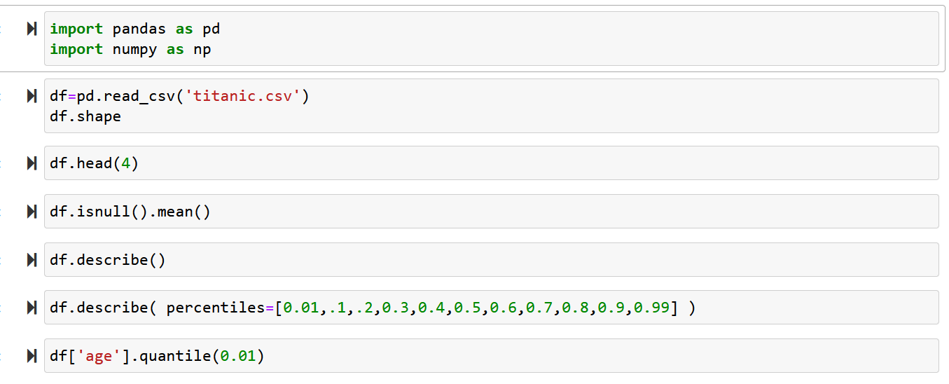
Manipulating Data
We use the Titanic dataset (your can download it from the course shell on Moodle, Module 4)
Use .head() or .tail() to check the first or last 5 (default) rows of the data frame
Using .shape to check the dimensions of the dataframe.
Using describe() to get descriptive statistics for any numeric columns.

Slide 7
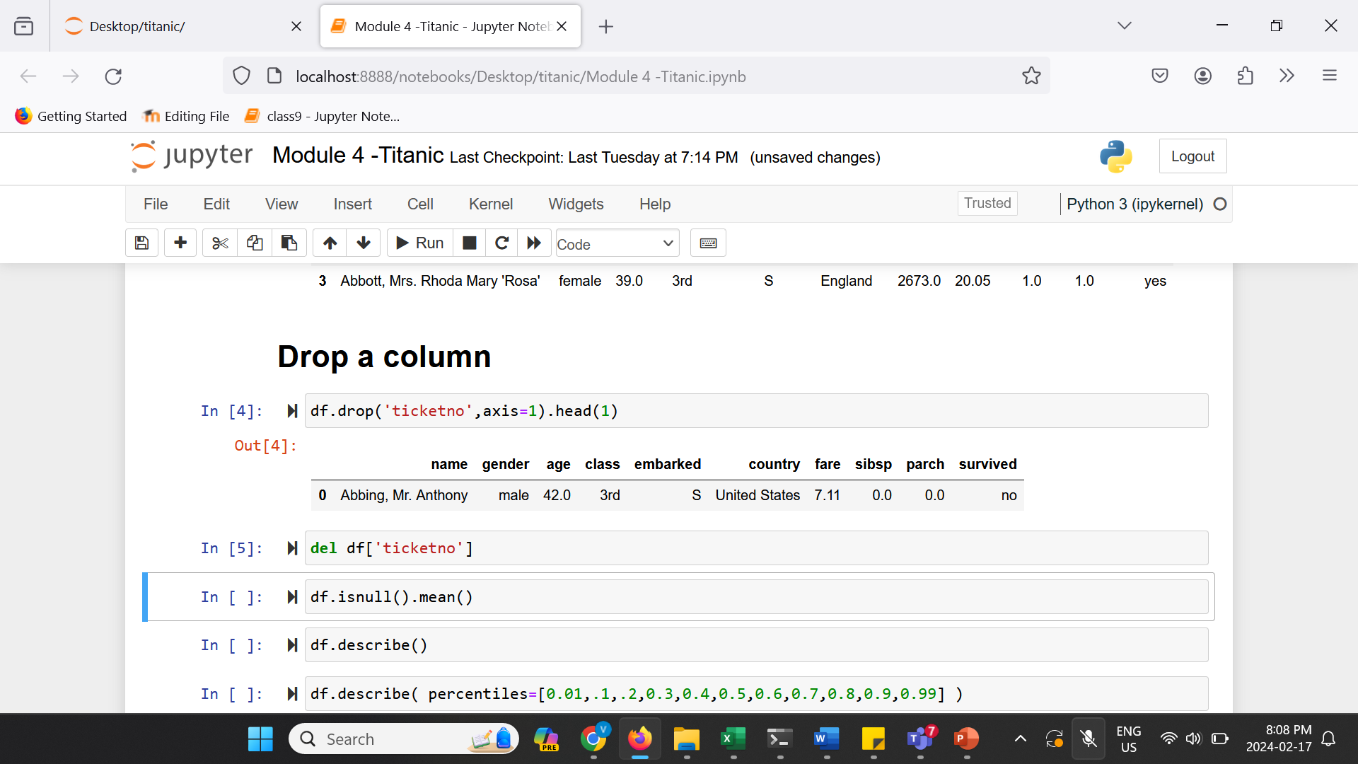
Remove unnecessary column
Using drop() to delete columns and rows.
Axis argument must be provided.
axis = 1 for columns and axis = 0 for rows.
Or use the following method to remove a columns permanently:

Slide 8
4.3 Navigate through data frames and parse individual or group elements

Slide 9
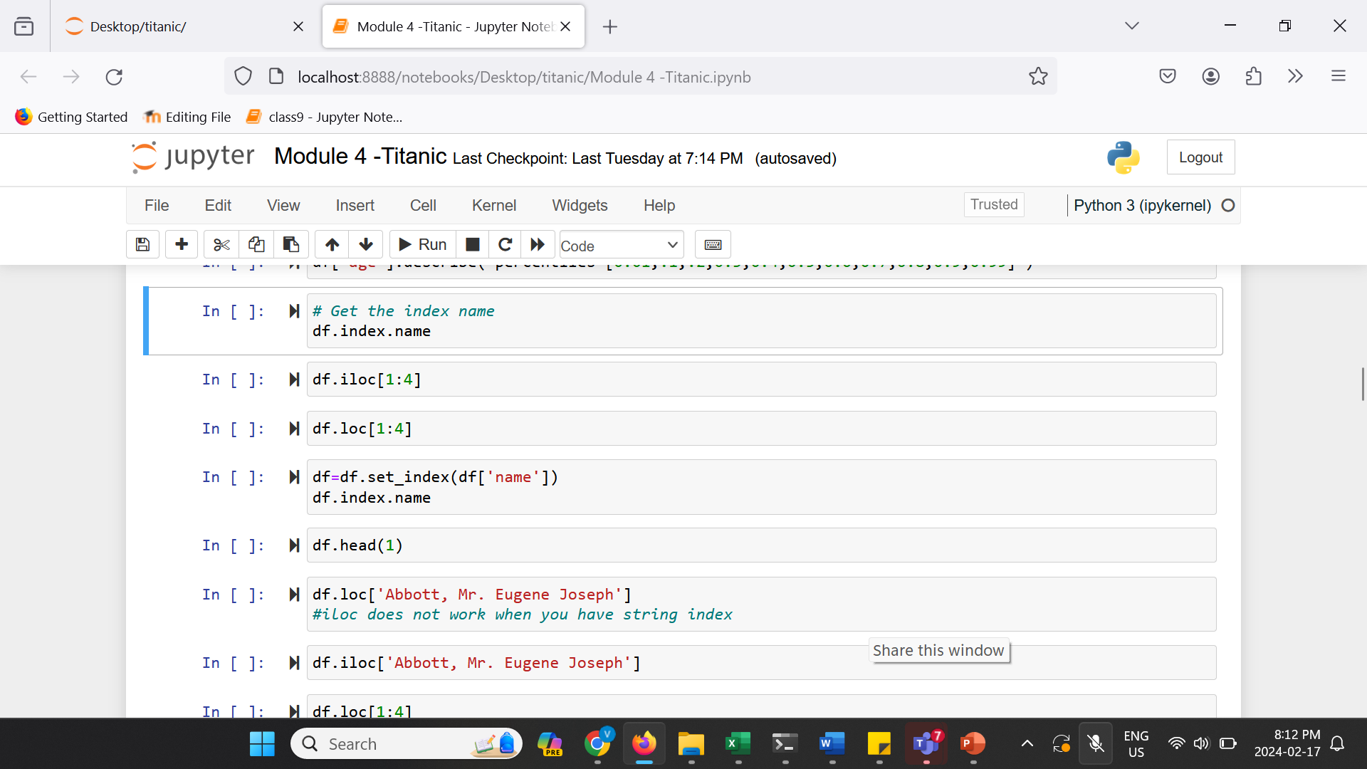
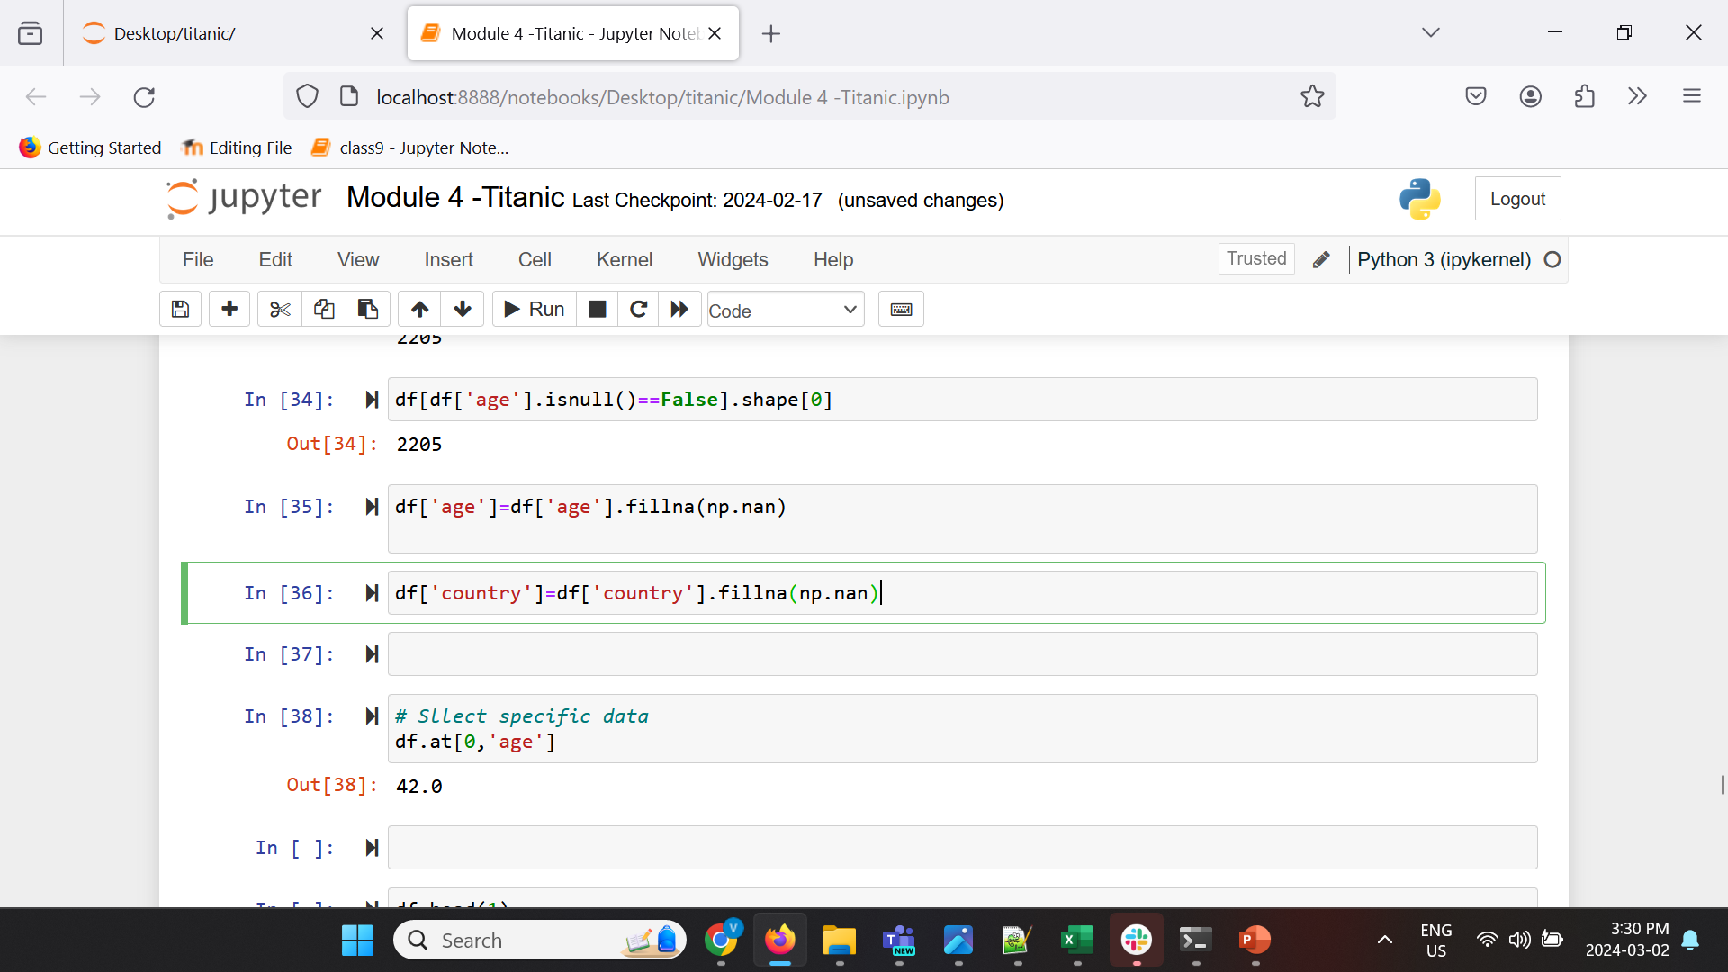
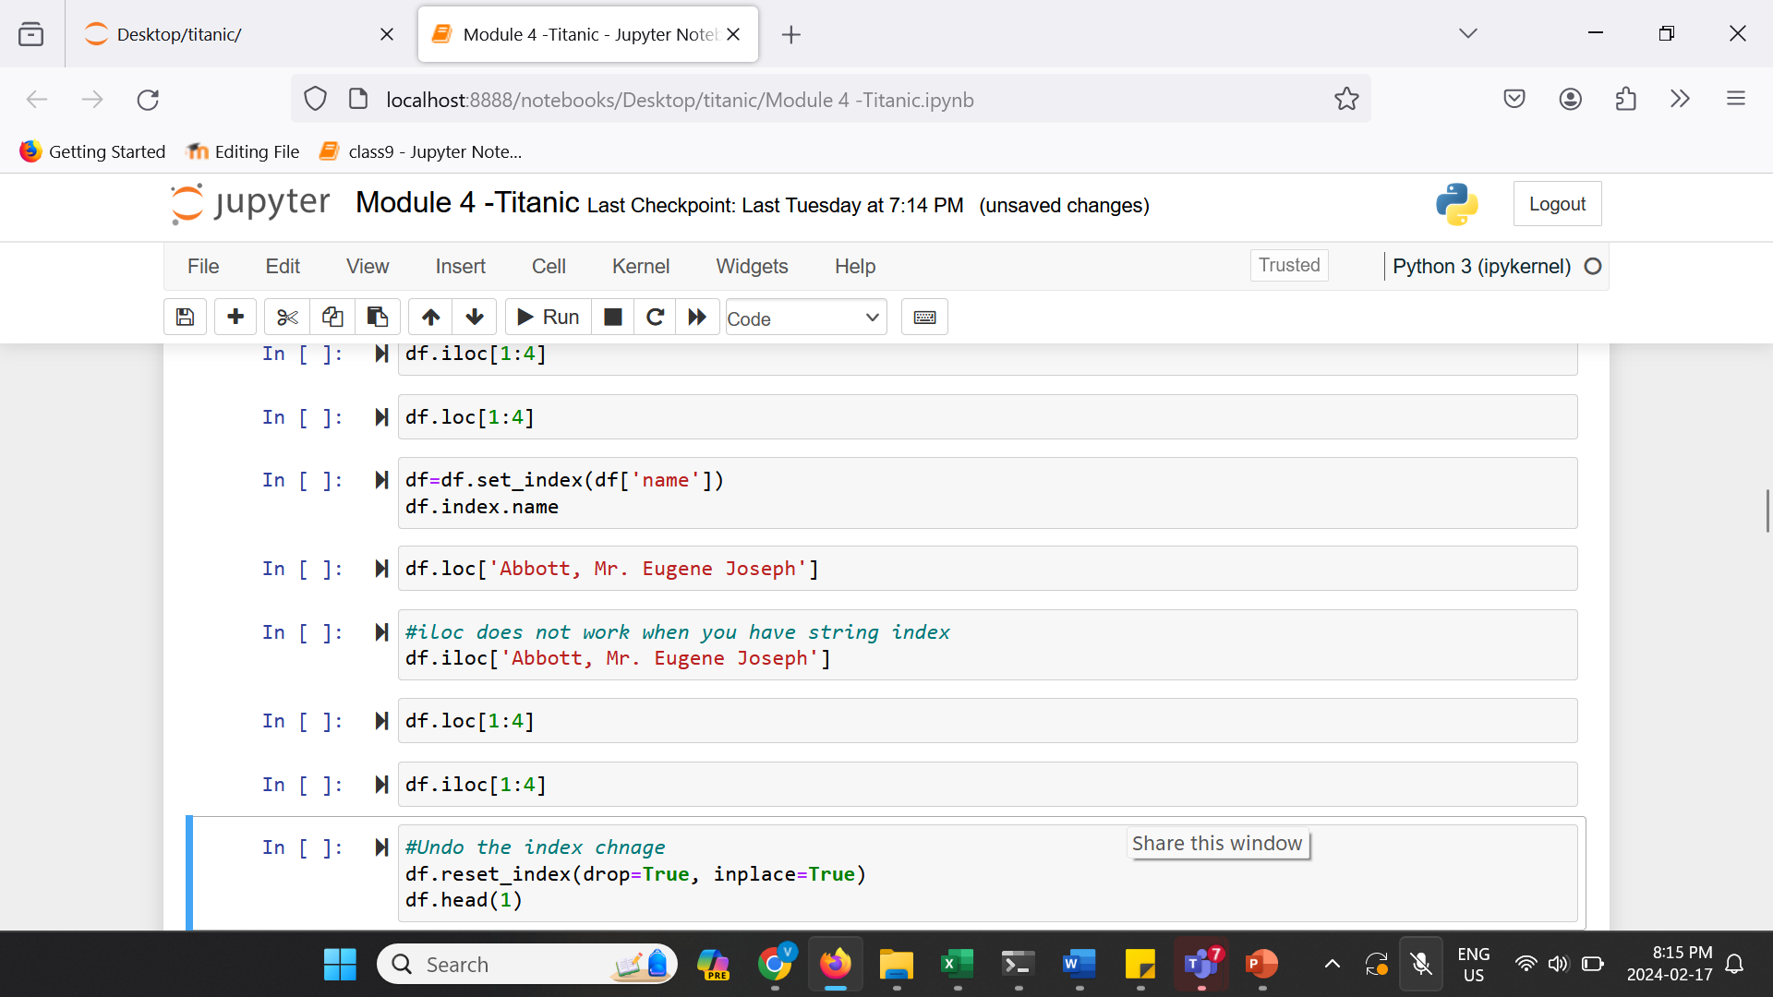
Navigating dataframe
Navigating dataframe using .iloc and .loc.
Change the index to a string column (‘name’) and use .loc and .loc

Slide 10
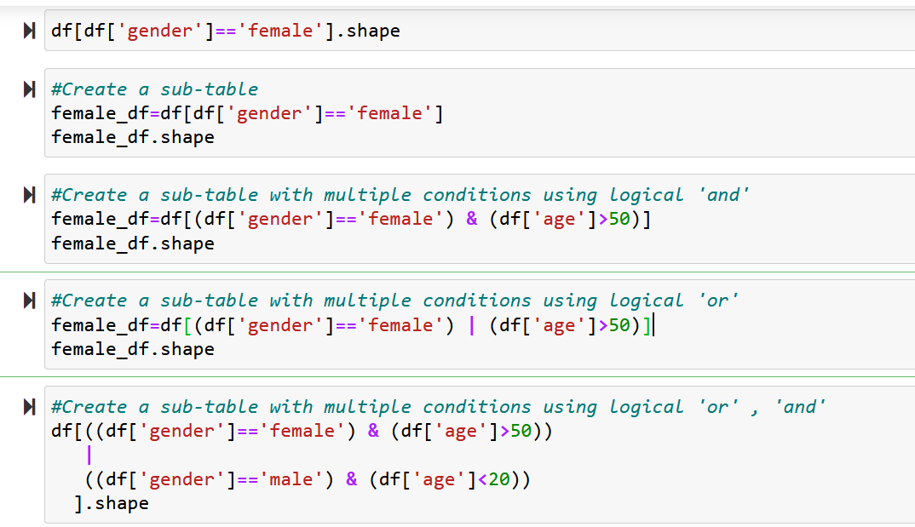
Navigating dataframe
Selecting Rows Based on Conditionals.

Slide 11
4.4 Use Python modules to adjust data frames

Slide 12
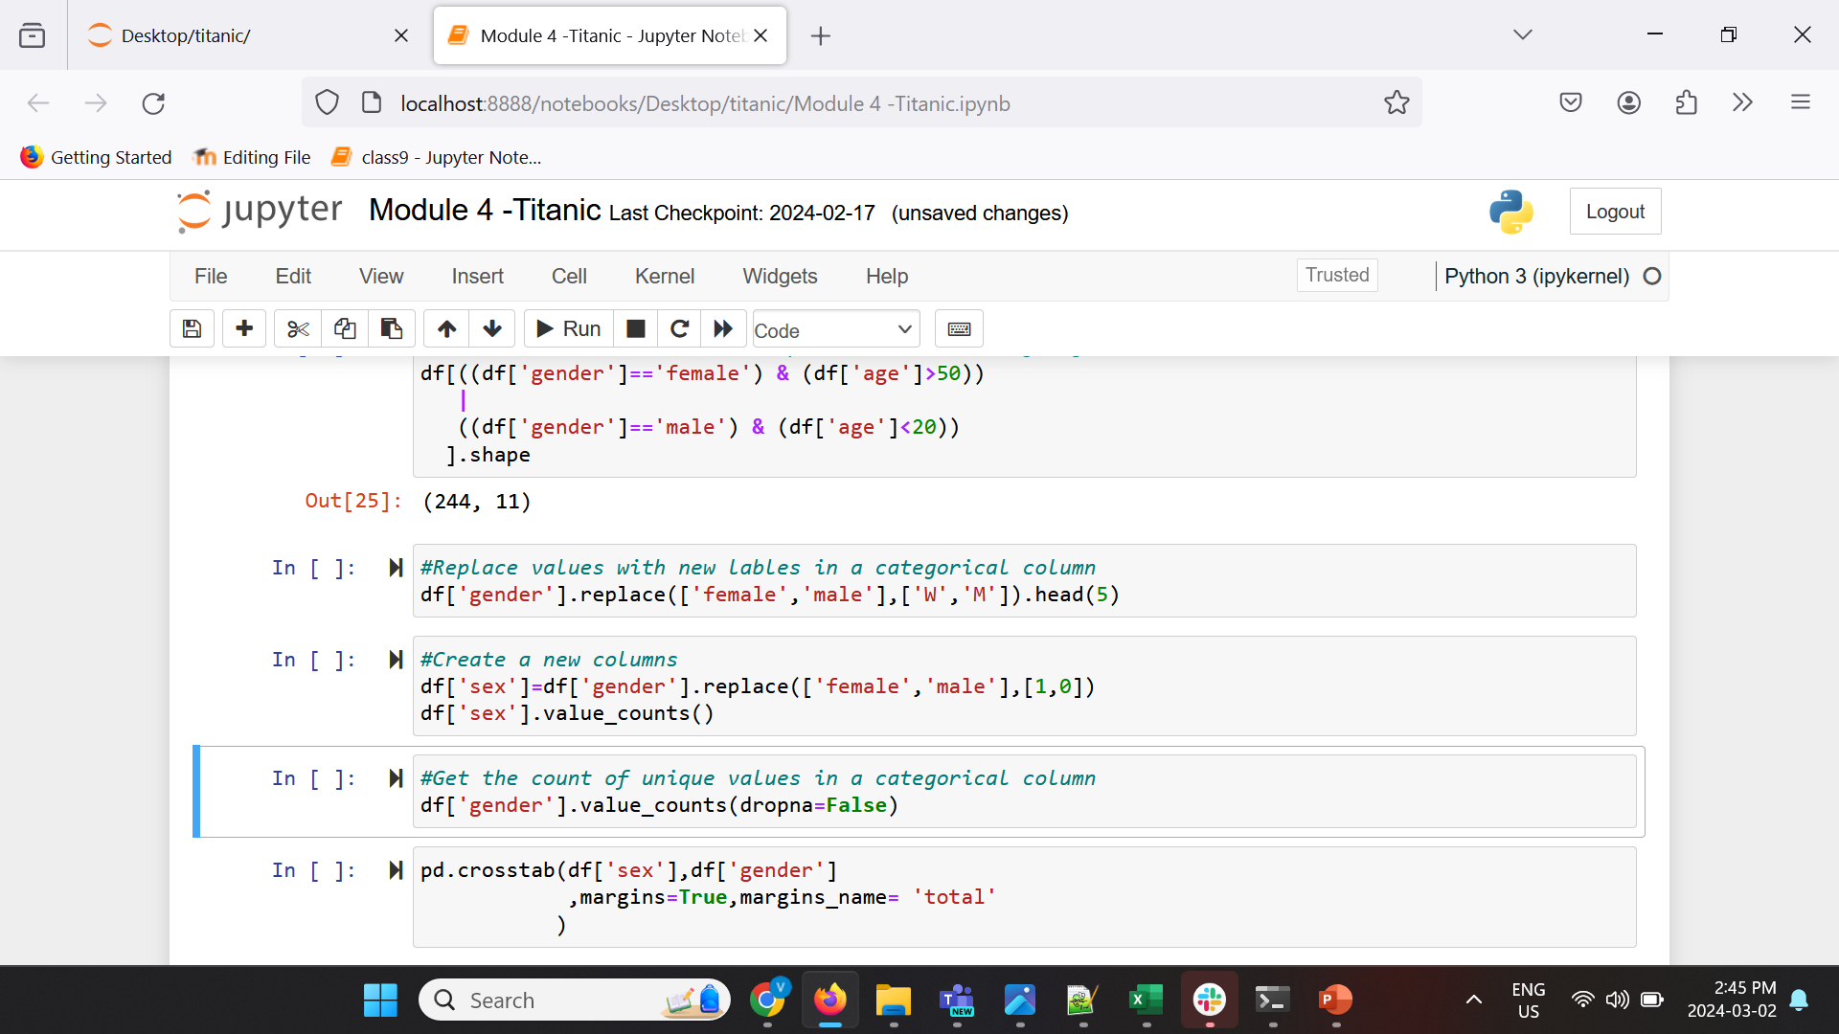
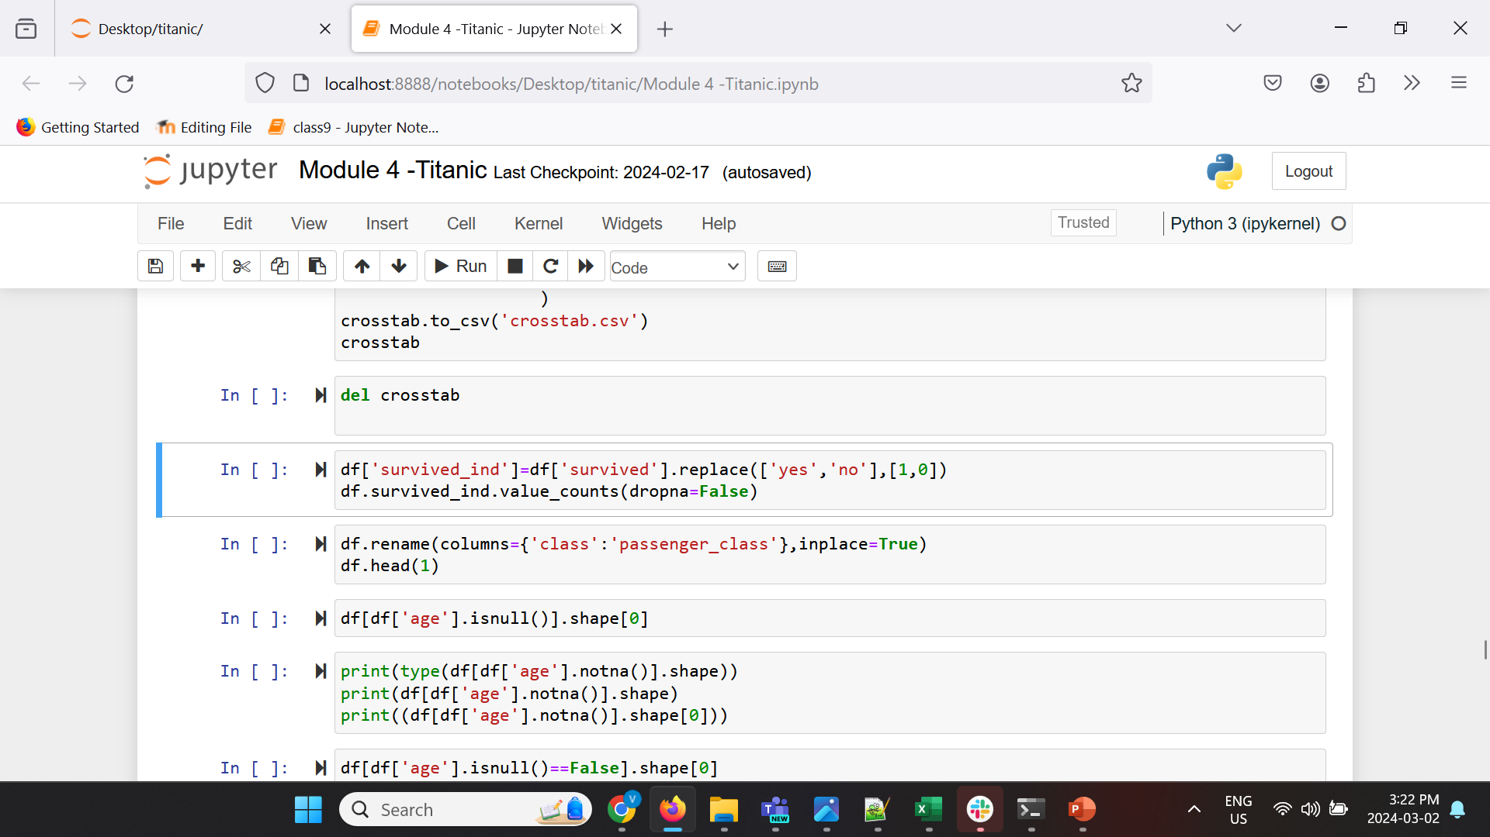
Adjusting dataframe
Using replace() to replace values.

Slide 13
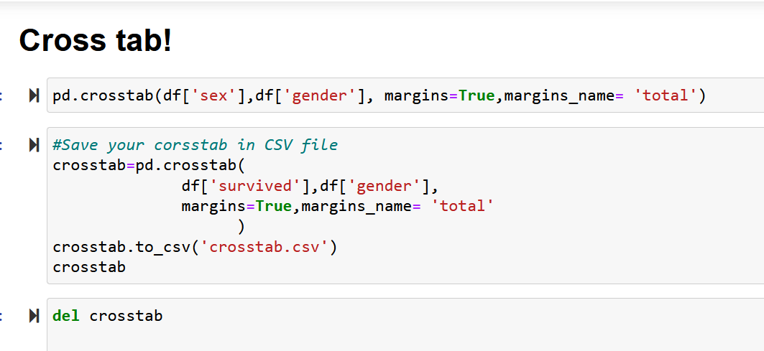
CrossTabs
Cross tabulation (crosstab) is a useful analysis tool commonly used to compare the results for one or more variables with the results of another variable.

Slide 14
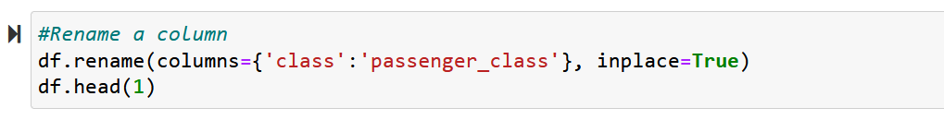
Adjusting dataframe
Using rename() to rename column names.
Question: What does the ‘inplace’ argument do in this code?

Slide 15
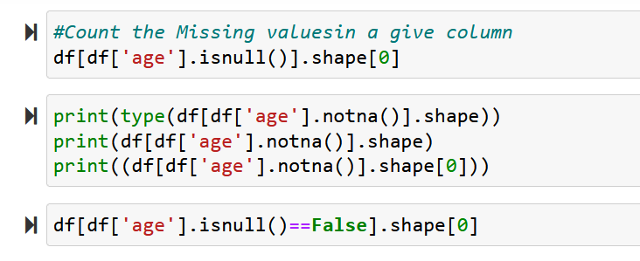
Adjusting dataframe
Using isnull() to find missing values.
Pandas fillna() function can be also used to address missing values in a dataframe (There are also other and better imputation methods that will be covered in Module 5).

Slide 16
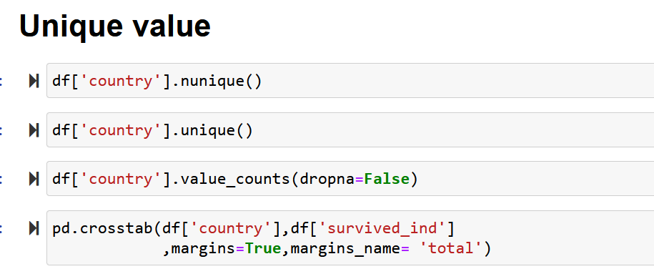
Unique values
Using unique() and nunique() to find unique values.
Using value_counts() to show unique values with the number of times each value appears.
Challenge question:
Work with the cross tab and calculate the % of survived/not survived within the passenger from each country?

Slide 17
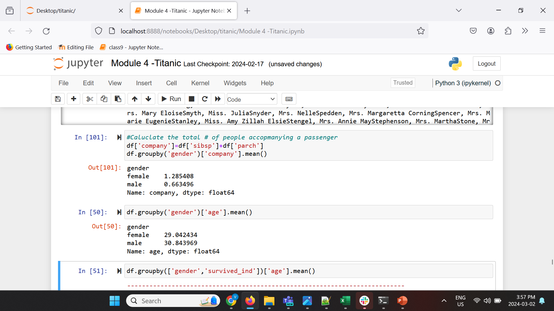
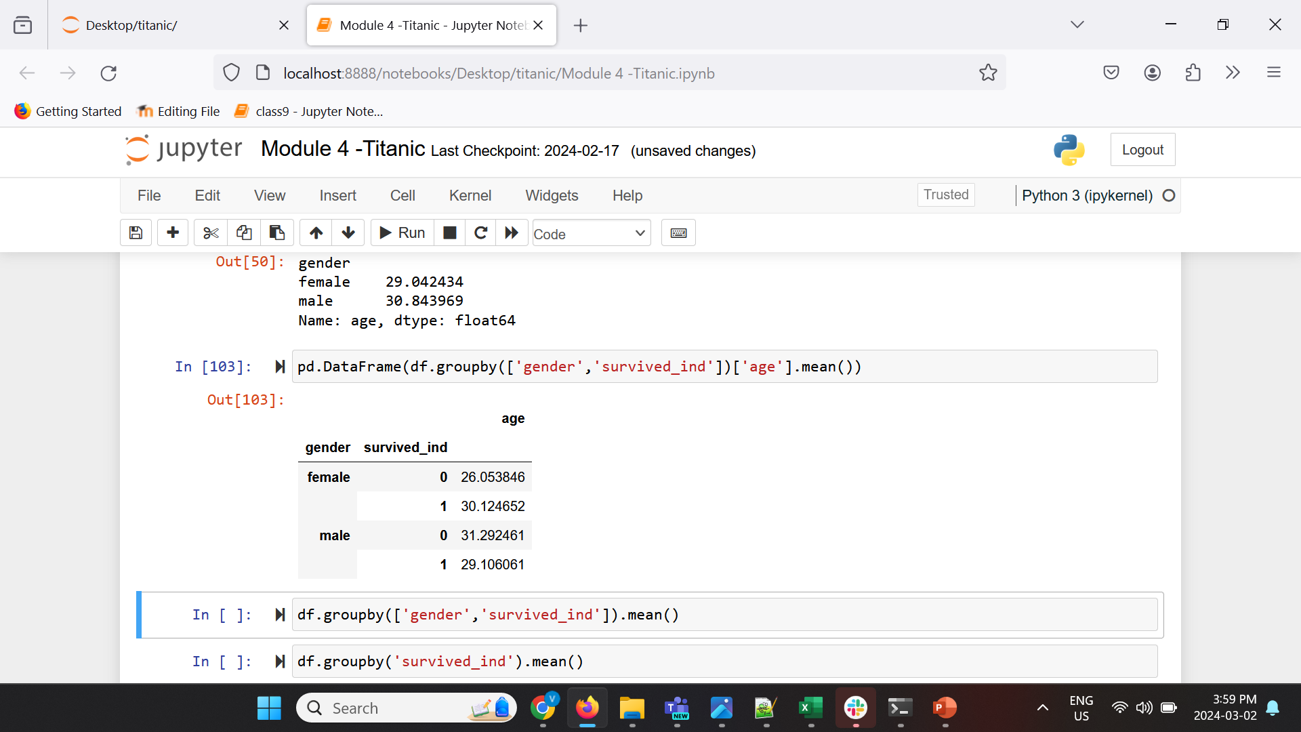
Grouping
Using groupby () to group individual rows according to some shared value.
For grouping to be useful, we need to group by something and then apply a function to each of those groups.

Slide 18
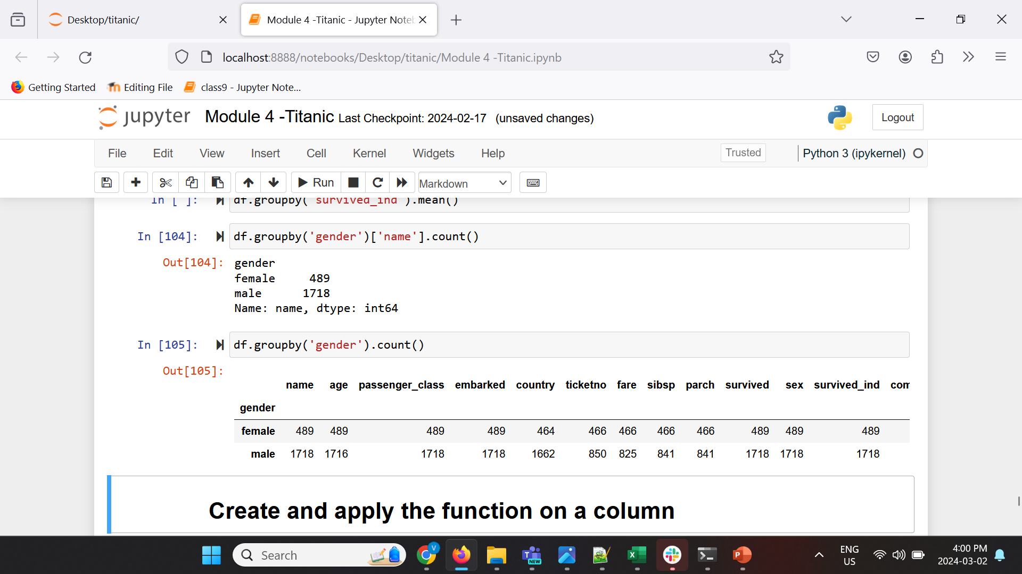
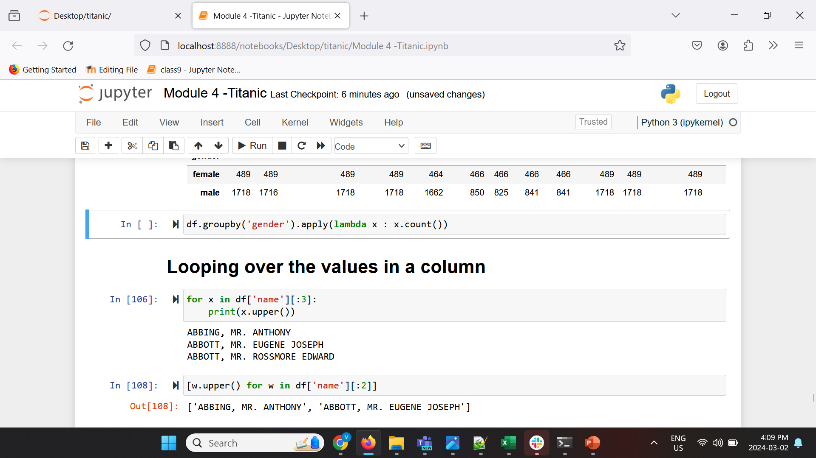
Grouping
We can use different functions with groupby, for example let’s use the count() function
Alternative method, using lambda :

Slide 19
4.5 Use Python modules to apply a function over all elements in a column

Slide 20
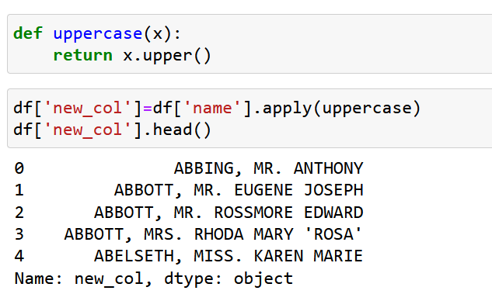
Applying a function on a column
Using apply to apply some function over all elements in a column .

Slide 21
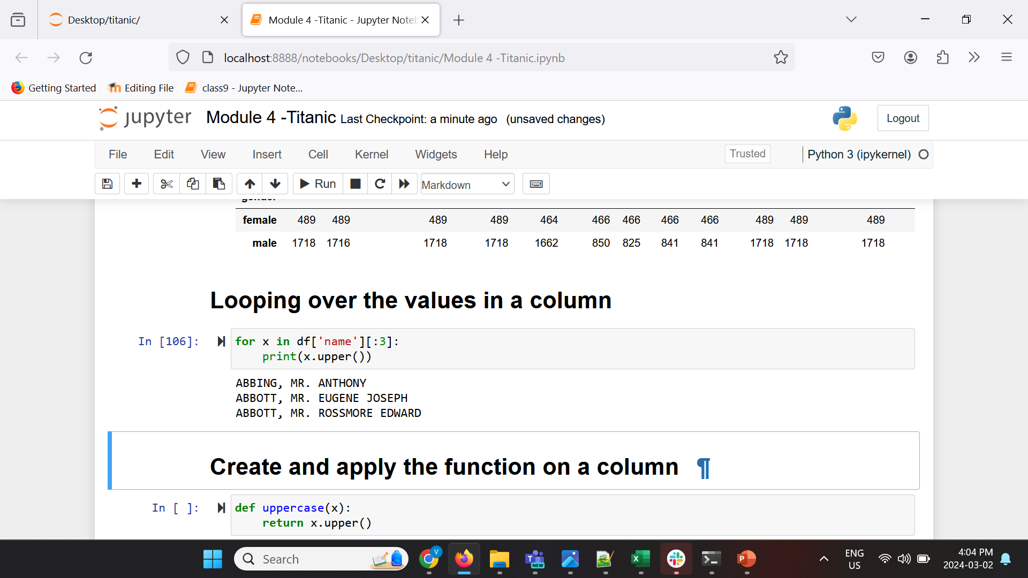
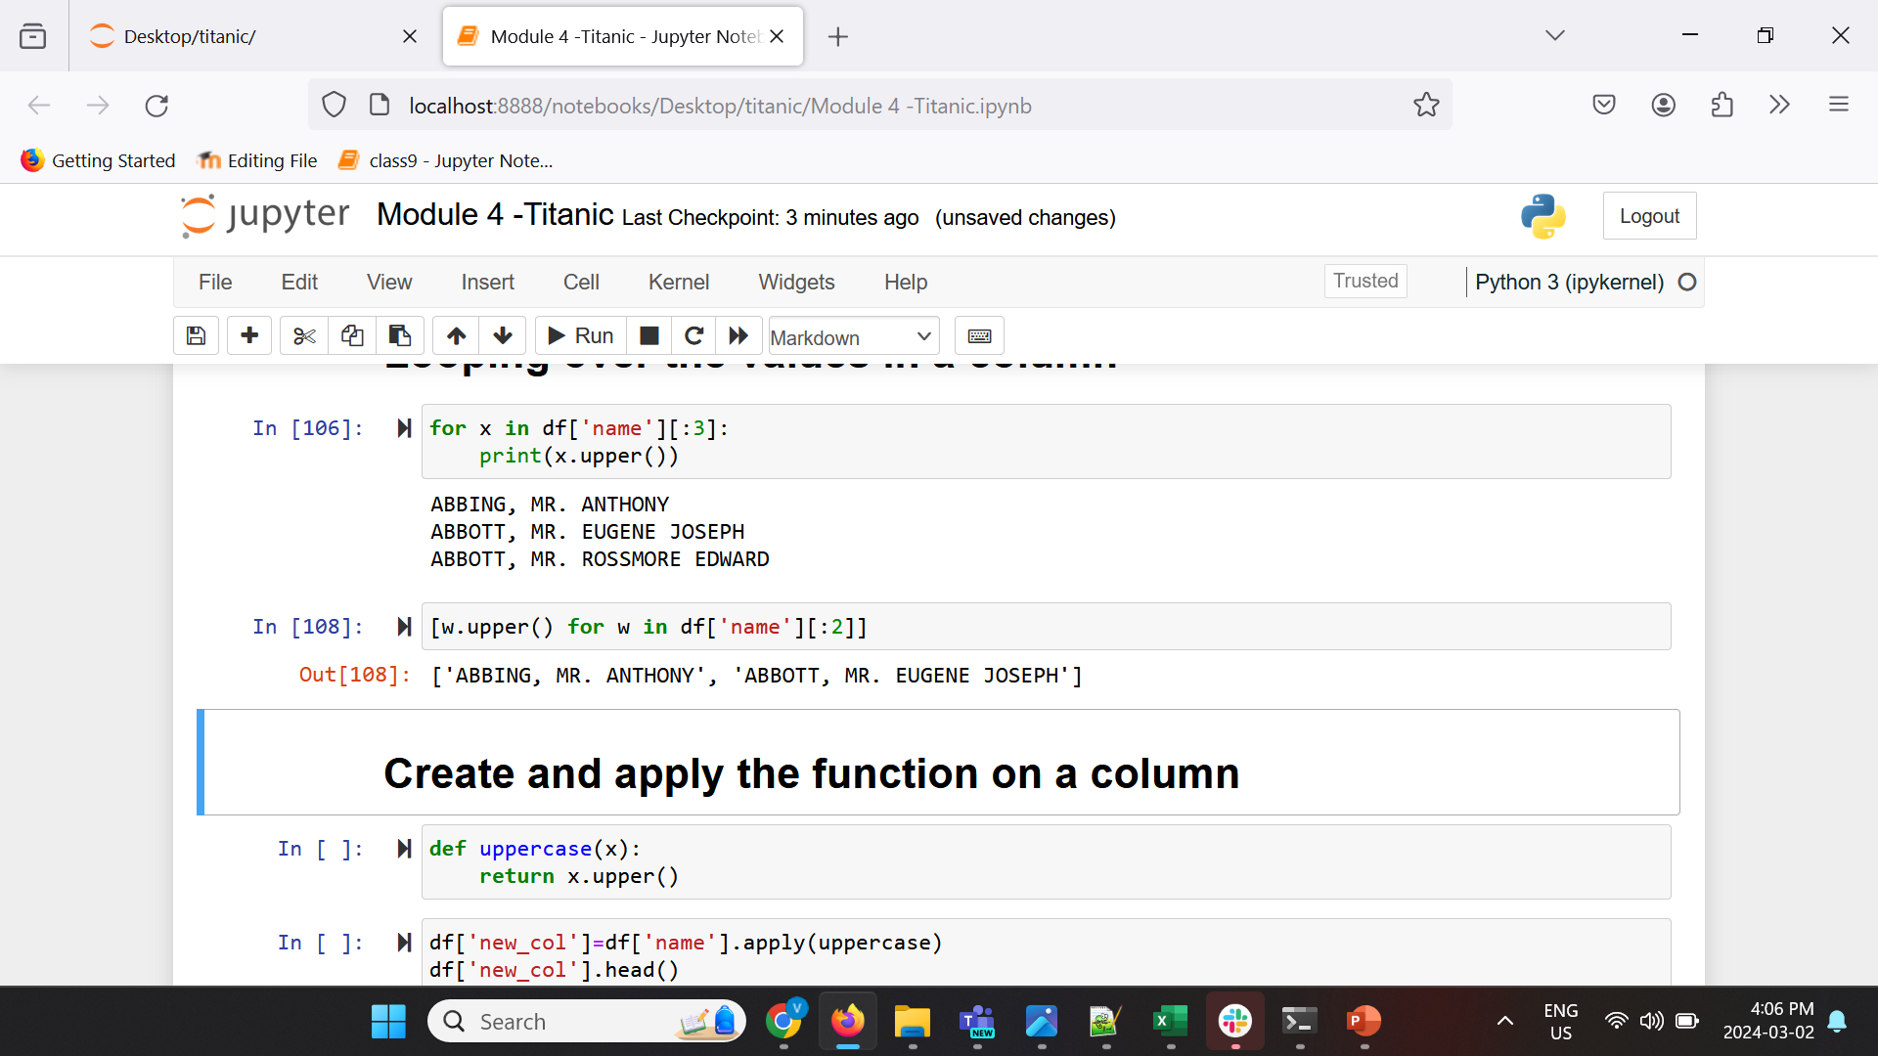
Looping over dataframe
Looping over a column.
Other methods:
Notes:
Section 2

Slide 22
4.6 Discuss various interactions with data and data frames in Python

Slide 23
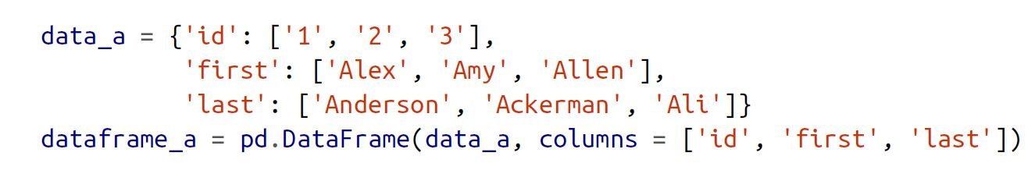
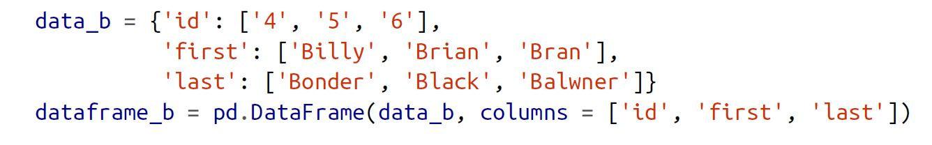
Concatenating
Using concat to concatenate two DataFrames.
We can set axis=0 to concatenate along the row axis (tables will be at the top of each other), and axis=1 to concatenate along the column axis (tables will be beside each other)

Slide 24
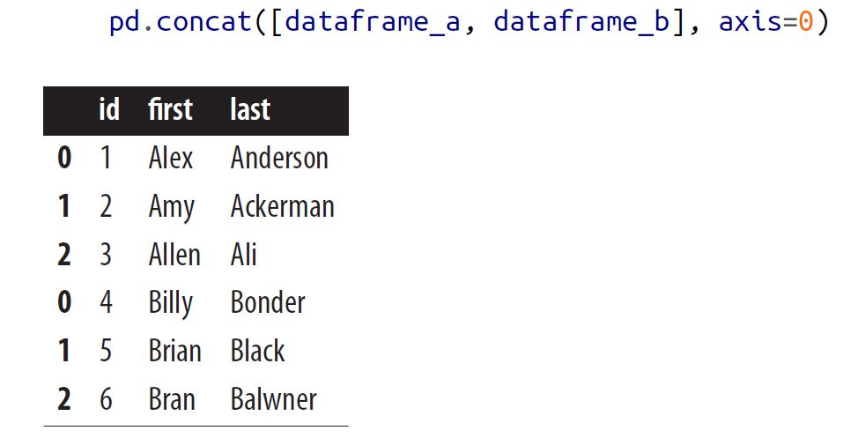
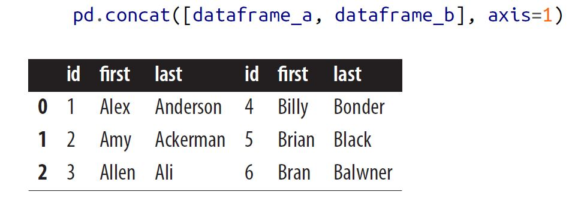
Concatenating

Slide 25
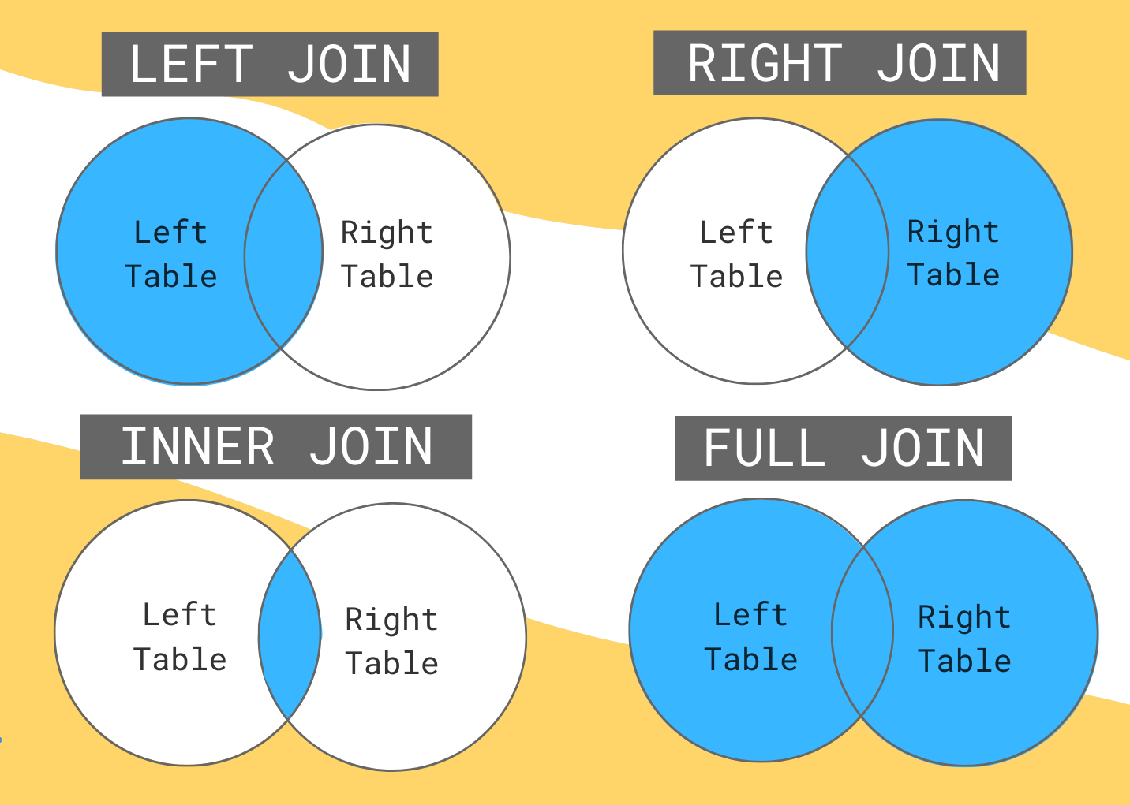
Merging (Also called Join)
Using merge to merge two DataFrames.
We can use ‘how’ parameter to specify the type of merge; outer, inner, left and right.

Slide 26
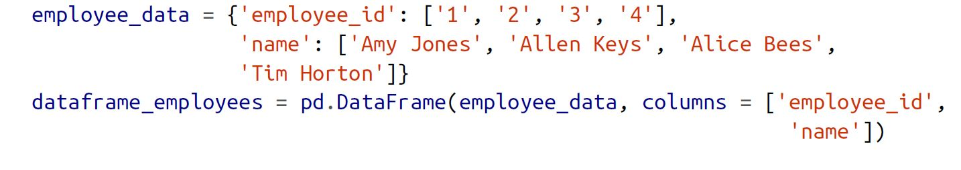
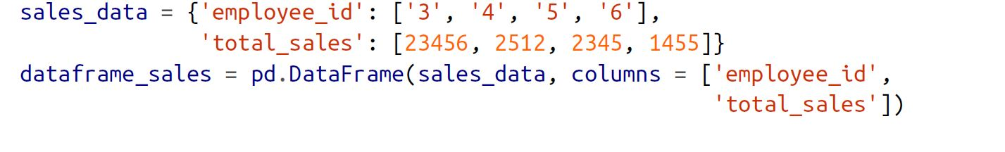
Merging
The default value for how is inner.

Slide 27
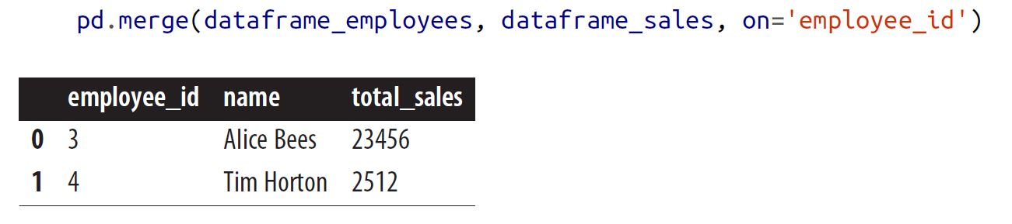
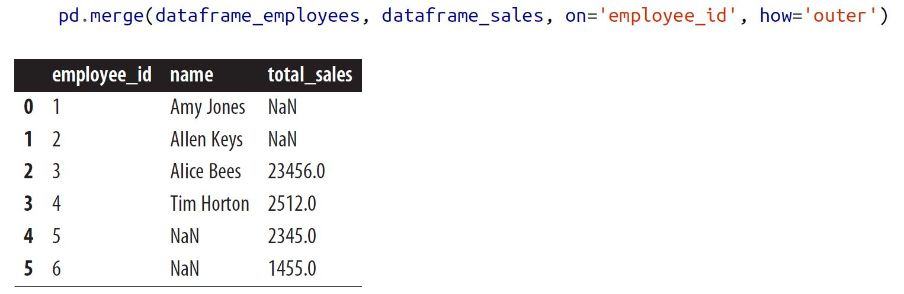
Merging
We use ‘on’ parameter to specify the shared column if that column has a same name in both dataframes.
If the shared column has two different names, we use ‘left_on’ , ‘right_on’ parameters

Slide 28
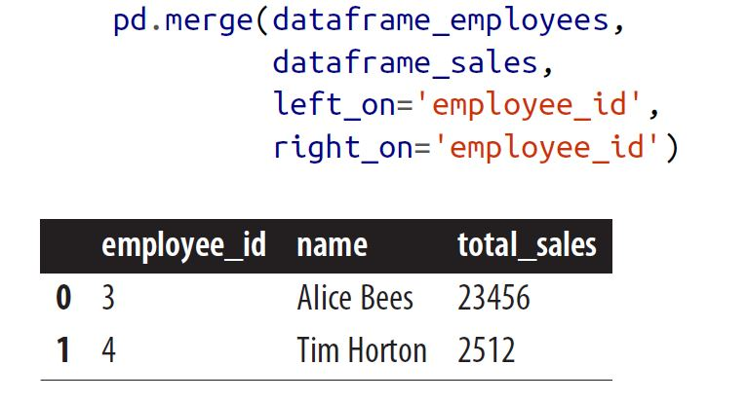
Merging
If instead of merging on two columns we want to merge on the indexes of each dataframe, we can use right_index=True and left_index=True.

Slide 29
Any questions so far? Any comments?

